Slide 1
EGR425 – Real-Time & Embedded Development
Kyungsoo Im, PhD
California Baptist University
Notes:
<number>

Slide 2
Lab3 Review
struct State {
uint8_t Out; // 6-bit pattern to output
uint16_t Time; // delay in 10ms units
uint8_t Next[4]; // next state for inputs 0,1,2,3
};
struct State FSM[8]={
{0x21,2000,{GO_N,WAIT_N,GO_N,WAIT_N}},
{0x22,1000,{GO_E,GO_E,GO_E,GO_E}},
{0x0C,2000,{GO_E,GO_E,WAIT_E,WAIT_E}},
{0x14,1000,{GO_N,GO_N,GO_N,GO_N}},
{0x22,1000,{WALK_N,WALK_N,WALK_N,WALK_N}},
{0x14,1000,{WALK_E,WALK_E,WALK_E,WALK_E}},
{0x64,2000,{GO_E,GO_E,GO_E,GO_E}},
{0x64,2000,{GO_N,GO_N,GO_N,GO_N}}
};
<number>

Slide 3
Lab3 Review
int main() {
//initialization
DDRD = ...; //LEDs
DDRC = ...; //buzzer and button
PORTC |= (1<<5); //enable pull up resistor
<number>

Slide 4
S = GO_N; //initial state
uint8_t i = 0;
while(1) {
for (i=0; i<4; i++) {
PORTD = FSM[S].Out; // set lights
delay_ms(FSM[S].Time);
while (((PINC & (1<<5)) == 0) && (S == WALK_N || S == WALK_E) );
S = FSM[S].Next[i];
if ((PINC & (1<<5)) == 0) { /* button is pressed now */
_delay_ms(5);
playNote(A6, NOTE_DURATION);
if ((PINC & (1<<5)) == 0) { /* still pressed */
if (S == GO_N || S == WAIT_N) { //simplified
S = WALKWAIT_N;
}
else if (S == GO_E || S == WAIT_E) { //simplified
S = WALKWAIT_E;
}
}
}
}
<number>

Slide 5
Today’s Topics
SPI
LCD
<number>

Slide 6

Recall Serial Communication
USART
Used baud rate: rate at which to transmit and receive data
Both devices have to agree to this rate
Overhead: for every 8 bits of data, 10 signals need to be sent
<number>

Slide 7

SPI : Modern Serial Protocol
Serial Peripheral Interface (SPI)
Protocol developed by Motorola which is used to communicate between microcontrollers and peripheral devices such as SD cards, Serial LCDs, ADC/DAC ICs, shift registers, etc.
Devices communicate in master/slave mode
Used primarily for synchronous serial communication between devices
Synchronous = uses a shared clock supplied by master
Full duplex communication
Transmit and receive data at the same time
<number>

Slide 8
Advantages of SPI
Full duplex communication
Devices communicate using a master/slave relationship. When the master generates a clock and selects a slave device, data may be transferred in either or both directions simultaneously.
Transfer data quickly
Data rates can range up to several megabits per second
Clock line synchronizes the 2 communicating devices
Devices agree to read and write data on the positive voltage transition (for instance). Then the bit rate can be as fast as the clock pulse at a particular frequency.
Usually starts at 1MHz and 10 MHz is standard. Up to 100MHz possible.
Simple protocol
But requires lots of lines (at least 4)
<number>

Slide 9
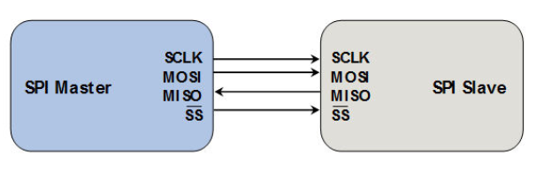
Inside SPI
Synchronous communication between master and slave
Master device responsible for generating the clock signal that the slave device receives
MOSI: Master Out Slave In: Send data to slave through the serial data out port.
MISO: Master In Slave Out: Receive the output from the slave through the serial data in port.
SS: Slave Select: Controls which slave device is currently active.
Can have multiple slaves
<number>

Slide 10
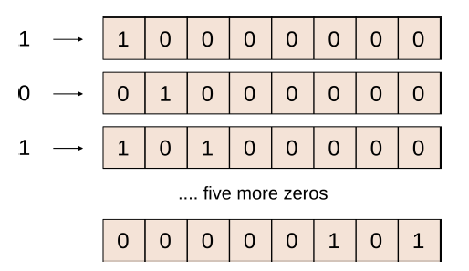
SPI Bus
Data transmission between master and slave happens through the use of shift registers
Same size shift register for master & slave (8-bit)
Example: 10100000 clocked in one bit at a time
At each clock pulse, the data in the register is shifted by one bit
After 8 clock pulses, the register contains the 8-bit data
<number>

Slide 11
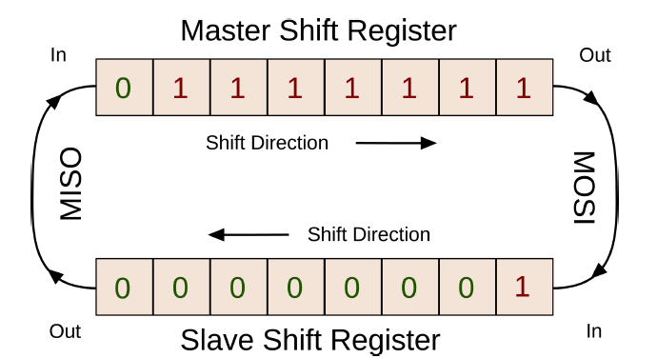
SPI Bus
Master and slave both have a shift register of the same size, and linked together
Each shift register is loaded with the data they want to transmit
At each clock pulse, bits are shifted
After 8 pulses, all 8-bits have traded places
Master would have received Slave’s data, and Slave would have Master’s data. And that’s why this is a full-duplex communication.
<number>

Slide 12
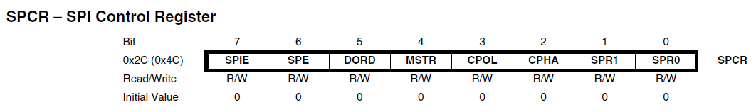
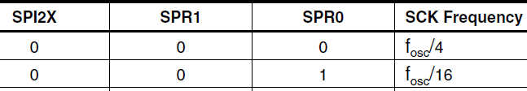
Using SPI – SPCR Register
SPCR controls SPI: Used to enable & configure SPI
SPCR |= 1<<SPE | 1<<MSTR | 1<<SPR0;
SPE: enable SPI
MSTR: SPI in Master mode
SPR0: Clock rate
Sets to 16MHz / 16 = 1MHz
<number>

Slide 13
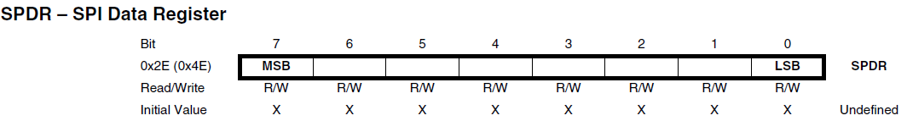
Using SPI – SPDR Register
SPDR is a read/write register used for data transfer
Writing SPDR sends data out MOSI
Reading SPDR gets the data that was clocked into MISO
Simply set this register with data to send to slave
SPDR = byte;
<number>

Slide 14
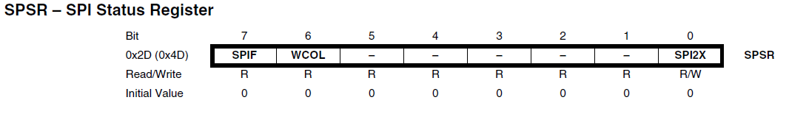
Using SPI – SPSR Register
SPSR is used to check if data transfer is complete
SPIF bit is set if when serial transfer is complete
In prev slide, you loaded the data to send in SPDR register:
SPDR = byte;
Now how to wait until the data has completed transfer?
while ( ! (SPSR & (1<<SPIF)) );
<number>

Slide 15
Using SPI Summary
Step 1) Enable SPI (Just once)
SPCR |= 1<<SPE | 1<<MSTR | 1<<SPR0;
Step 2) Load the data you want to transmit to slave
SPDR = bytes;
Step 3) Wait until data transfer is complete
while ( !(SPSR & (1<<SPIF)) );
<number>

Slide 16
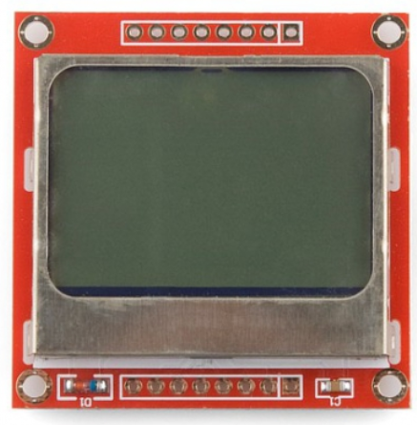
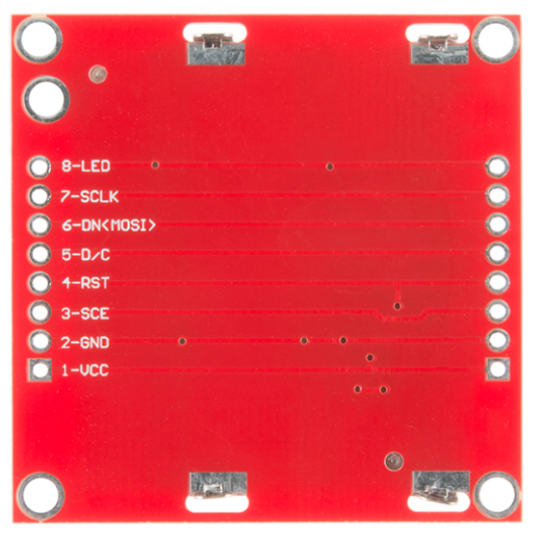
Using SPI with 48x84 pixels LCD
48 x 84 Dot LCD Display
Total of 4032 pixels
Serial Bus Interface with maximum high speed 4 Mbits/s
Manufactured by Philips
LED Back-Light
Run at 3.3 Volt
Low power consumption; it is suitable for battery applications
<number>

Slide 17
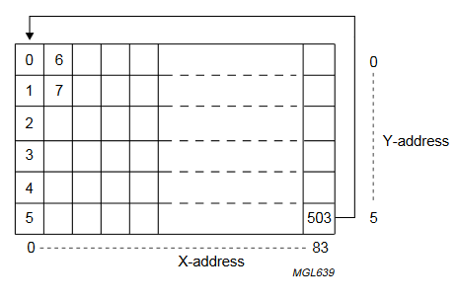
48x84 Pixels LCD
Total of 4032 pixels
504 addresses total
Each address is a byte
504 x 8 bits = 4032
To fill up the LCD, send 504 bytes total
<number>

Slide 18
48x84 Pixels LCD – Writing 1 byte of data
write_data(0xFF);
Writes 1 byte of data to LCD
8 bits
.
.
.
.
.
.
.
.
<number>

Slide 19
48x84 Pixels LCD – Writing bytes horizontally
for (x=0; x<84; x++) {
write_data(0xFF);
}
Writes 1 byte of data to LCD x 84 times horizontally across LCD
8 bits
...........................................
…………………………………………
…………………………………………
…………………………………………
…………………………………………
…………………………………………
…………………………………………
…………………………………………
<number>

Slide 20
504 bytes = 4032 pixels = 48x84 LCD
//fill up the entire screen
for (y=0; y<6; y++) {
for (x=0; x<84; x++) {
write_data(0xFF);
}
}
...........................................
…………………………………………
…………………………………………
…………………………………………
…………………………………………
…………………………………………
…………………………………………
…………………………………………
...........................................
…………………………………………
…………………………………………
…………………………………………
…………………………………………
…………………………………………
…………………………………………
…………………………………………
...........................................
…………………………………………
…………………………………………
…………………………………………
…………………………………………
…………………………………………
…………………………………………
…………………………………………
<number>

Slide 21
Pixel Representation
.
.
.
.
.
.
.
.
0xFF = 11111111 = 8 dots
0x7E = 01111110 = 6 dots
0x11 = 00010001 = 2 dots
Character ‘A’ = { 0x7e, 0x11, 0x11, 0x11, 0x7e }
Hex codes with all ASCII characters given in lcd_chars.h
.
.
.
.
.
.
.
.
.
.
.
.
.
.
.
.
.
.
.
.
.
.
.
.
.
.
<number>

Slide 22
Just a matter of sending bytes to LCD...
Use SPI to send bytes to SPI
AVR is master
LCD is slave
Only send data
Not receiving data from slave
<number>

Slide 23
Lab 4 Example
https://youtu.be/iQSFJLGOfmA
<number>

Slide 24
Take 5
<number>

Slide 25
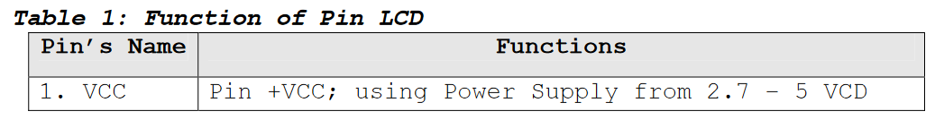
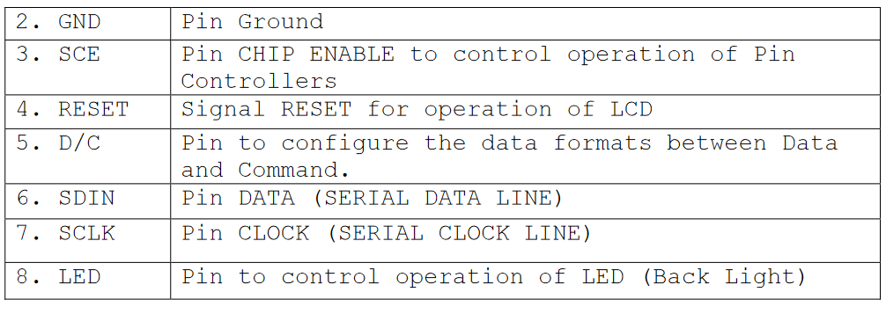
Functions of LCD
<number>

Slide 26

Hardware Wiring
Some must use specific ports defined in datasheet for SPI
Pin 10 (PB2) = default for chip select (Slave select)
Pin 11 (PB3) = Serial Data In to slave (MOSI)
Pin 13 (PB5) = Clock line always
Pin 12 (PB4) = Slave out data into master (not using)
For backlight, any output pin but use w/ 1K resistor
Pin9
Pin8
<number>

Slide 27
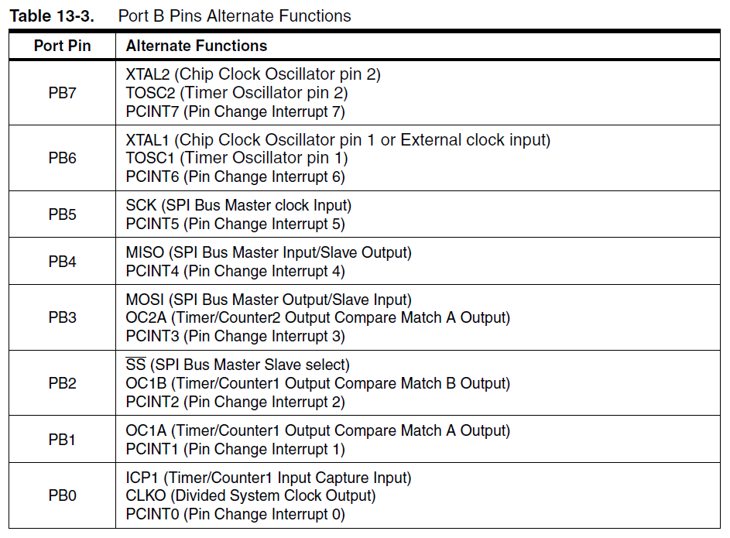
From Datasheet
<number>

Slide 28
Configuring the LCD – init()
Step 1) Set data direction register
DDR_LCD |= 1<<LCD_SCE | 1<<LCD_RST | 1<<LCD_DC | 1<<LCD_DIN | 1<<LCD_CLK;
Because we are using more 3 different ports and 15 pins, names can become confusing. Avoid hardcoding from here on.
<number>

Slide 29
Use #define to give meaningful names
#define PORT_LCD PORTB
#define DDR_LCD DDRB
//SERIAL CHIP ENABLE to SLAVE SELECT : default pin 10
#define LCD_SCE 2
//SIGNAL RESET for operation of LCD
#define LCD_RST 0
//DATA OR COMMAND
#define LCD_DC 1
//DATA IN TO SLAVE always pin 11 (MOSI)
#define LCD_DIN 3
//clock line always pin 13 (SERIAL CLOCK)
#define LCD_CLK 5
<number>

Slide 30
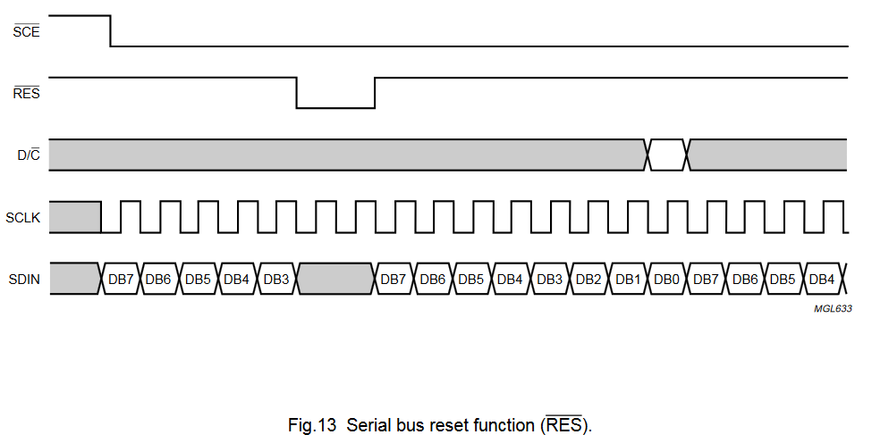
Configuring the LCD – init()
Step 2) Reset the LCD display
<number>

Slide 31
Configuring the LCD – init()
Step 2) Reset the LCD display
PORT_LCD |= (1 << LCD_RST);
PORT_LCD &= ~(1 << LCD_SCE);
_delay_ms(50);
PORT_LCD &= ~(1 << LCD_RST);
_delay_ms(100);
PORT_LCD |= (1 << LCD_RST);
<number>

Slide 32
Configuring the LCD – init()
Step 3) Enable SPI
SPCR |= 1<<SPE | 1<<MSTR | 1<<SPR0;
<number>

Slide 33
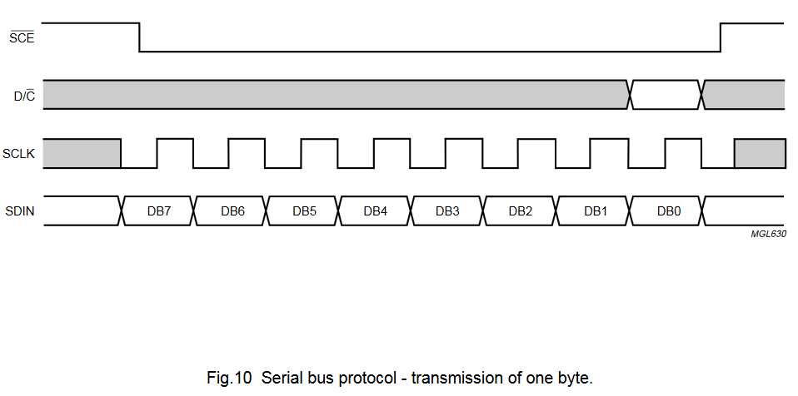
Sending data to LCD– writecmd(), writedata()
Now we are ready to transmit data to LCD
Idea is to send a byte at a time to the LCD
By setting the appropriate port with correct signals
And use SPI to actually transmit a byte
<number>

Slide 34
Sending data to LCD – writecmd(), writedata()
D/C = Data or Command
LOW = command, HIGH = Data
SCE = LOW during transmission
Use SPI to load data to register and wait until transmission is complete
SCE = HIGH after transmission
<number>

Slide 35
LCD Commands
Commands to configure LCD is given in lab4.c file
/* -LCD Extended Commands mode- */
write_cmd(0x21);
/* LCD bias mode 1:48 */
write_cmd(0x13);
... ...
Need to have correct values for LCD to work
<number>

Slide 36
LCD Data
To display on LCD screen, transmit bytes
From Master (AVR) to Slave (LCD)
Total 504 bytes
To clear the LCD screen:
for (i = 0; i < 504; i++)
write_data(0x00);
<number>

Slide 37
Displaying Images to LCD
Many tools that will take a Bitmap image and convert to bytes
Input = Bitmap in 48 x 84 pixels
Output = 504 bytes (each byte in hex)
Simply send each byte to LCD to draw the image
http://en.radzio.dxp.pl/bitmap_converter/
<number>

Slide 38
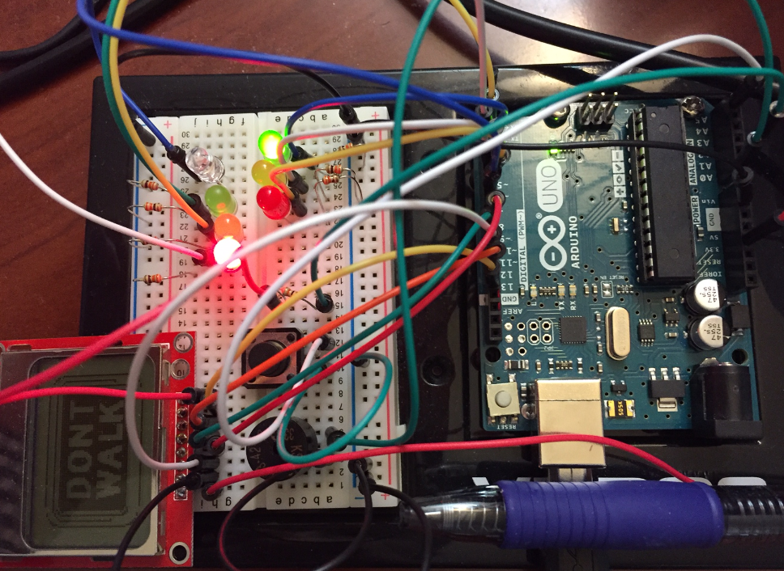
Lab4 – LCD
Will add to your traffic light system
Need to make space for LCD (all of PortB)
Move your LEDs to PortD and button/buzzer to empty pins (PortC)
<number>

Slide 39
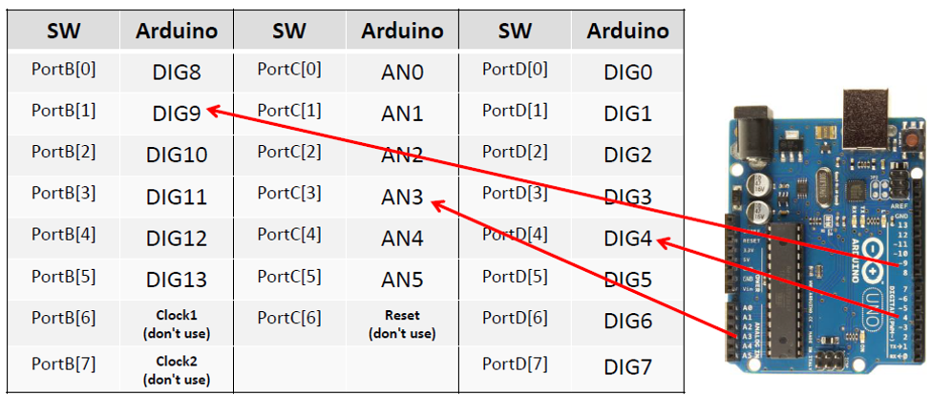
Port Name Mapping
<number>

Slide 40
Check LCD
<number>

